Slide 1
Classify Me Please
Ryan preston - Depth Security
@awsmHacks
Notes:
Little on classification. Waste your time on How auth works. Short lil attack.

Slide 2
What are you protecting?
Can you provide a list of your company’s assets?
Did you count the VM clusters, Cloud Resources, *nix Machine?
How about if I asked:
What’s currently facing the internet?
How many total systems do you have?
Where is your data?
How many vendors do you have?
Which vendors have what kind of your data

Slide 3
There’s an app for that
Enterprise asset management (EAM)
Microsoft System Center Configuration Manager (SCCM a.k.a. ConfigMgr)
Patch Management Software
The ‘All in one’ Solutions: Firewalls, NAC, Patching and more
UpKeep
Infor
FIIX
FasTrak
eMaint CMMS
Maintenance Connection
FTMaintenance
Asset Essentials
KaseyaVSA
ConnectWise
PatchManager
PulseWay
ManageEngine
SysAid
Jamf Pro
Automox

Slide 4

Active Classification
Products that aim to profile newly joined devices on the network:
Firewalls
“Distributed Firewalls”
IDS
IPS

Slide 5

Active Classification
Connects

Slide 6
Active Classification
Attempts to identify host

Slide 7
Active Classification
Looks at ports/services/domain/etc..

Slide 8
Active Classification
Agent might push data up

Slide 9
Active Classification
If Good: Moves out of DMZ//Allows network access

Slide 10
Active Classification
X
If Bad: Stays in DMZ, Restricted/No network access

Slide 11
Passive Classification
Products that aim to profile newly joined devices on the network:
Firewalls
“Distributed Firewalls”
IDS
IPS
(Same types of devices)

Slide 12
Passive Classification
Connects

Slide 13
Passive Classification
Allows network access

Slide 14
Passive Classification
Monitors traffic and attempts to ID devices
Sending Traffic

Slide 15
Passive Classification
X
Notices ‘malicious’ traffic, segments or kicks off network
Sends ‘malicious’ Traffic

Slide 16
Passive Classification
X
Notices CC data exiting the network
Attempt to pull sensitive data

Slide 17
Attackers Mindset
Attacking a network:
1st Enumerate the external network
2nd Break in
3rd Enumerate the internal network
4th Move around network to access moar data/creds/privileges

Slide 18
Attackers Mindset
Attacking a network:
1st Enumerate the external network
2nd Break in
3rd Enumerate the internal network
4th Move around network to access moar data/creds/privileges
Notes:
Hackers focus on knowing all the assets

Slide 19
Enum yo self
SenseOfSecurity ~ ADRecon
https://github.com/sense-of-security/ADRecon
Bloodhound
https://github.com/BloodHoundAD/
PingCastle
https://www.pingcastle.com/
nmap/masscan

Slide 20
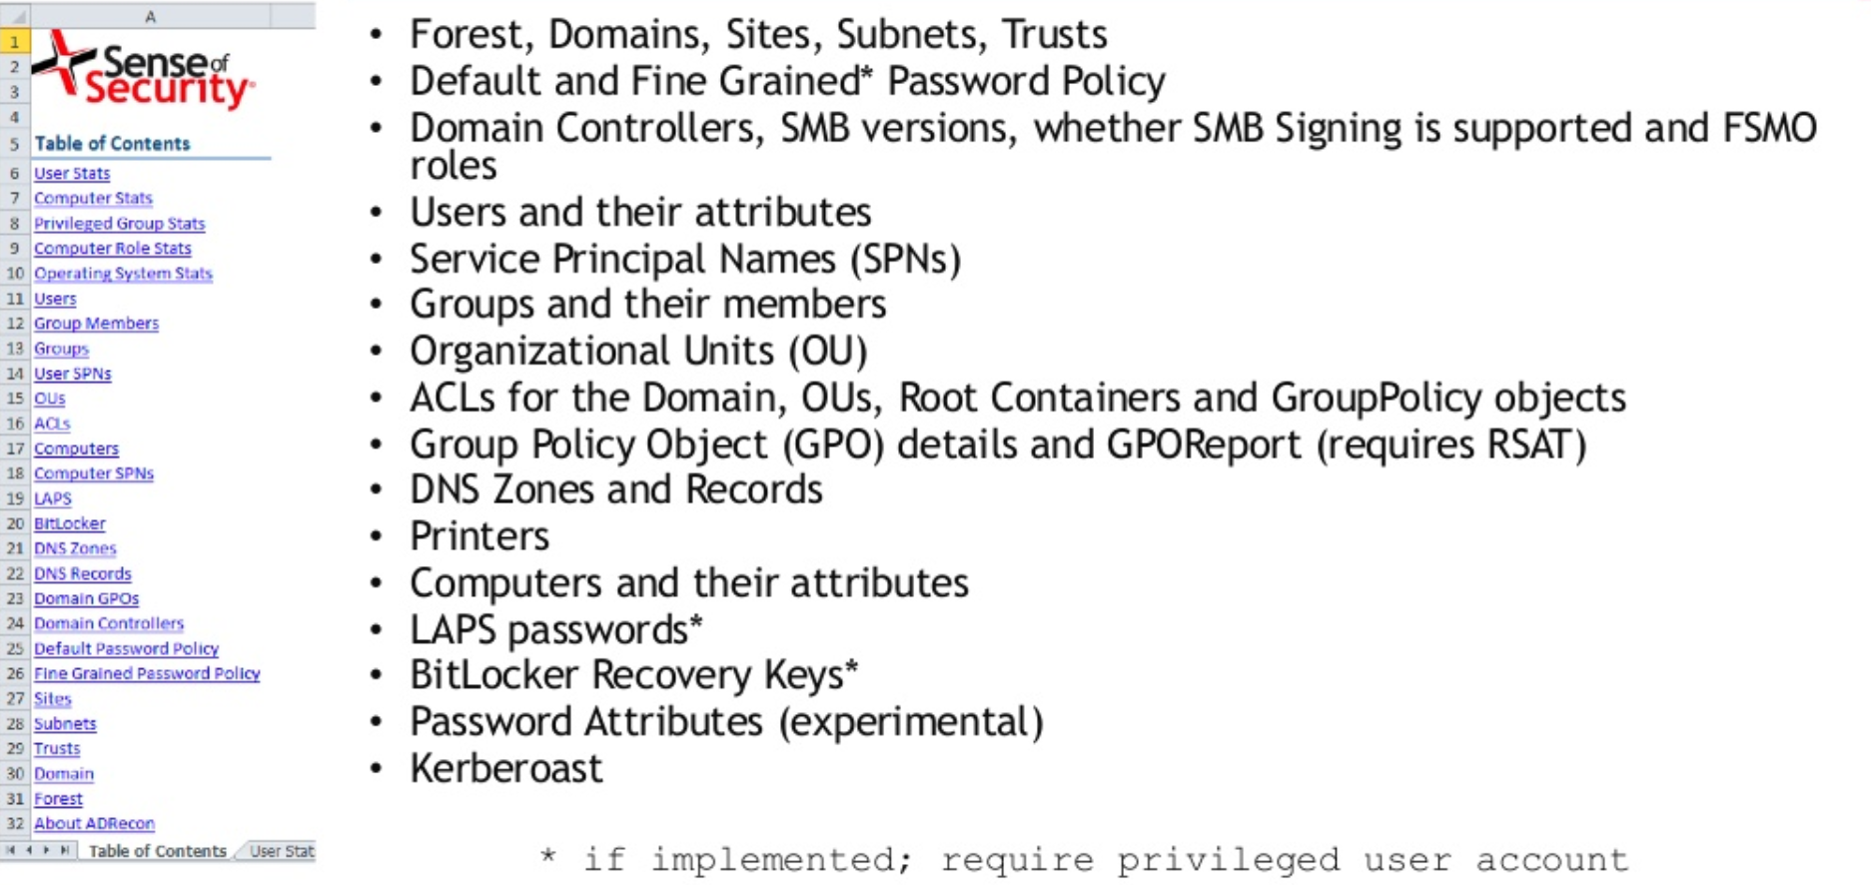
Enum yo self
SenseOfSecurity ~ ADRecon
https://github.com/sense-of-security/ADRecon
Bloodhound
https://github.com/BloodHoundAD/
PingCastle
https://www.pingcastle.com/
nmap/masscan
https://www.slideshare.net/prashant3535/adrecon-bh-usa-2018-arsenal-and-def-con-26-demo-labs-presentation

Slide 21
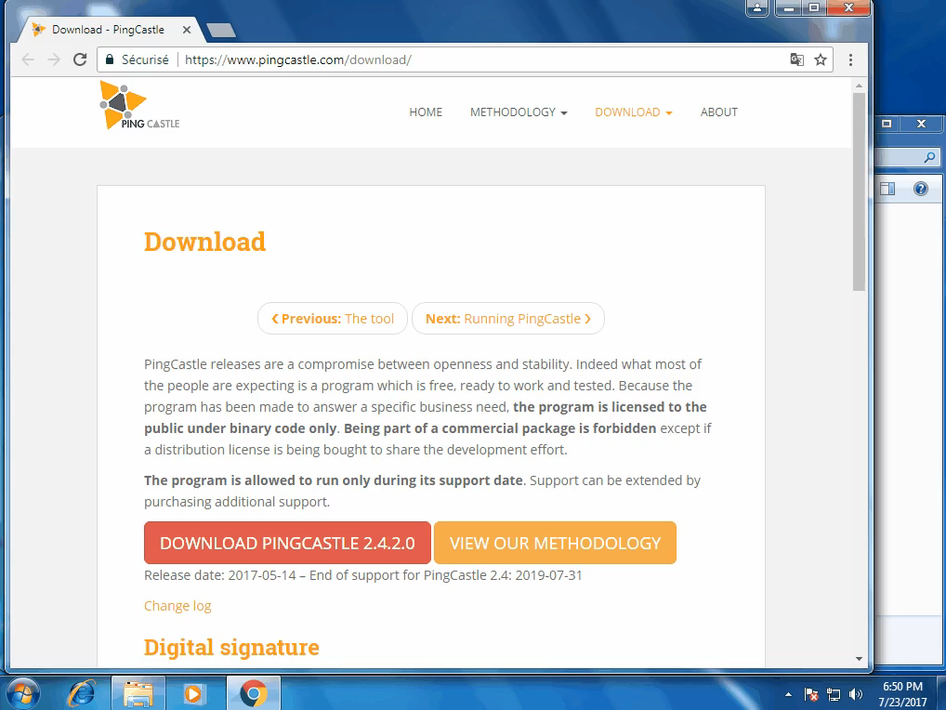

Slide 22
Enum yo self
SenseOfSecurity ~ ADRecon
https://github.com/sense-of-security/ADRecon
Bloodhound
https://github.com/BloodHoundAD/
PingCastle
https://www.pingcastle.com/
nmap/masscan

Slide 23
Have a list and check it twice
Why would merely having a list help with security?
Take the pressure off the firewalls/AV by knowing your network
Struts 2018
Wouldn’t it be nice….
In case of a compromise, we have an easy list of potentially vulnerable machines to investigate.
You spent how much on security products this year? But cant get a list of devices? It would take just one person.

Slide 24
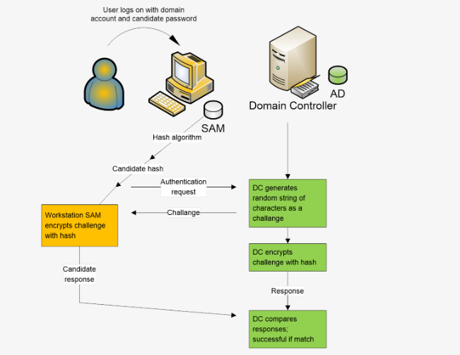
NTLM Authentication
Computer makes an authentication request
2) DC answers with a challenge
3) Computer responds with challenge encrypted using password hash
4) DC checks if challenge response matches what it expects
https://www.ultimatewindowssecurity.com/securitylog/book/page.aspx?spid=chapter4

Slide 25
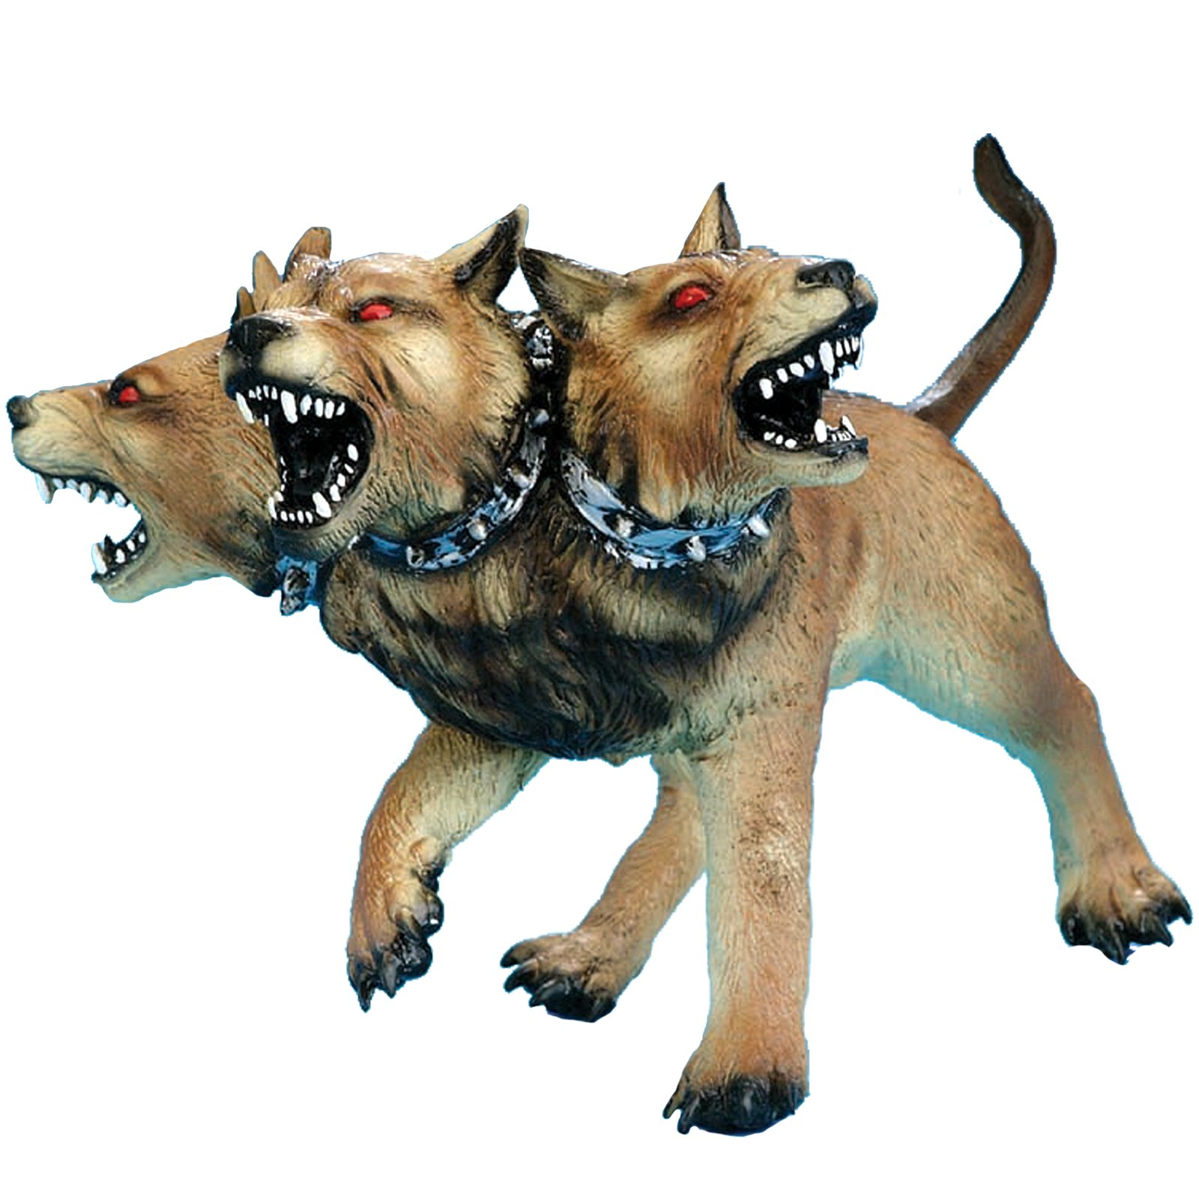
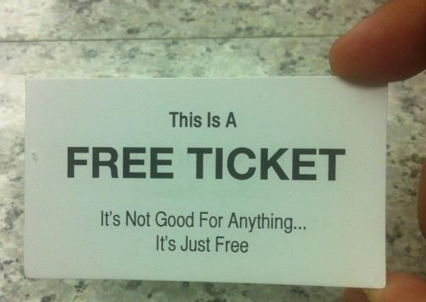
KERBEROS Authentication
Make’s use of tickets
Tickets are session specific data values
2 Kinds:
Authentication Tickets aka Ticket-Granting Tickets
Service Tickets
When first authenticating, the DC sends back the auth ticket and a session key that’s encrypted with the clients personal key(password).
The Client uses the personal key to decrypt the session key.
Auth tickets are used to ask for Service Tickets

Slide 26


KERBEROS Authentication
Fred enters his credentials into fred-pc
Fred’s PC makes an authentication request
KDC answers with a challenge
Computer responds with challenge encrypted using a hash of Freds password.
KDC checks if challenge response matches what it expects
If its good, provides a TGT to Fred-PC
Fred-PC now needs to obtain a Service Ticket for itself.
---A Service ticket authenticates Fred to Fred-PC and lets him logon
If Fred has drives mapped, Fred-PC request more Service Tickets (using the TGT)
A logon process collects identification and authentication information and then uses Local Security Authority services to log on users.
Fred-PC

Slide 27
KERBEROS Authentication
Fred enters his credentials into fred-pc
Fred’s PC makes an authentication request - Sends Username
KDC answers with a challenge
Computer responds with challenge encrypted using a hash of Freds password.
KDC checks if challenge response matches what it expects
If its good, provides a TGT to Fred-PC
Fred-PC now needs to obtain a Service Ticket for itself.
---A Service ticket authenticates Fred to Fred-PC and lets him logon
If Fred has drives mapped, Fred-PC request more Service Tickets (using the TGT)
A logon process collects identification and authentication information and then uses Local Security Authority services to log on users.
AS-REQ to AS
Fred-PC

Slide 28
KERBEROS Authentication
Fred enters his credentials into fred-pc
Fred’s PC makes an authentication request
KDC answers with a challenge
Computer responds with challenge encrypted using a hash of Freds password.
KDC checks if challenge response matches what it expects
If its good, provides a TGT to Fred-PC
Fred-PC now needs to obtain a Service Ticket for itself.
---A Service ticket authenticates Fred to Fred-PC and lets him logon
If Fred has drives mapped, Fred-PC request more Service Tickets (using the TGT)
A logon process collects identification and authentication information and then uses Local Security Authority services to log on users.
AS-REP Challenge
Fred-PC

Slide 29
KERBEROS Authentication
Fred enters his credentials into fred-pc
Fred’s PC makes an authentication request
KDC answers with a challenge
Fred-PC responds with the challenge encrypted using a hash of Freds password.
KDC checks if challenge response matches what it expects
If its good, provides a TGT to Fred-PC
Fred-PC now needs to obtain a Service Ticket for itself.
---A Service ticket authenticates Fred to Fred-PC and lets him logon
If Fred has drives mapped, Fred-PC request more Service Tickets (using the TGT)
A logon process collects identification and authentication information and then uses Local Security Authority services to log on users.
AS-REQ Challenge
Fred-PC

Slide 30
KERBEROS Authentication
Fred enters his credentials into fred-pc
Fred’s PC makes an authentication request
KDC answers with a challenge
Computer responds with challenge encrypted using a hash of Freds password.
KDC checks if challenge response matches what it expects
If its good, provides a TGT to Fred-PC
Fred-PC now needs to obtain a Service Ticket for itself.
---A Service ticket authenticates Fred to Fred-PC and lets him logon
If Fred has drives mapped, Fred-PC request more Service Tickets (using the TGT)
A logon process collects identification and authentication information and then uses Local Security Authority services to log on users.
Fred-PC

Slide 31
KERBEROS Authentication
Fred enters his credentials into fred-pc
Fred’s PC makes an authentication request
KDC answers with a challenge
Computer responds with challenge encrypted using a hash of Freds password.
KDC checks if challenge response matches what it expects
If its good, provides a TGT to Fred-PC
Fred-PC now needs to obtain a Service Ticket for itself.
---A Service ticket authenticates Fred to Fred-PC and lets him logon
If Fred has drives mapped, Fred-PC request more Service Tickets (using the TGT)
A logon process collects identification and authentication information and then uses Local Security Authority services to log on users.
TGT
Fred-PC

Slide 32
KERBEROS Authentication
Fred enters his credentials into fred-pc
Fred’s PC makes an authentication request
KDC answers with a challenge
Computer responds with challenge encrypted using a hash of Freds password.
KDC checks if challenge response matches what it expects
If its good, provides a TGT to Fred-PC
Fred-PC now needs to obtain a Service Ticket for itself.
---A Service ticket authenticates Fred to Fred-PC and lets him logon
If Fred has drives mapped, Fred-PC request more Service Tickets (using the TGT)
A logon process collects identification and authentication information and then uses Local Security Authority services to log on users.
TGT:: TGS_REQ
Fred-PC

Slide 33
KERBEROS Authentication
Fred enters his credentials into fred-pc
Fred’s PC makes an authentication request
KDC answers with a challenge
Computer responds with challenge encrypted using a hash of Freds password.
KDC checks if challenge response matches what it expects
If its good, provides a TGT to Fred-PC
Fred-PC now needs to obtain a Service Ticket for itself.
---A Service ticket authenticates Fred to Fred-PC and lets him logon
If Fred has drives mapped, Fred-PC request more Service Tickets (using the TGT)
A logon process collects identification and authentication information and then uses Local Security Authority services to log on users.
Service Ticket
Fred-PC

Slide 34
KERBEROS Authentication
Fred enters his credentials into fred-pc
Fred’s PC makes an authentication request
KDC answers with a challenge
Computer responds with challenge encrypted using a hash of Freds password.
KDC checks if challenge response matches what it expects
If its good, provides a TGT to Fred-PC
Fred-PC now needs to obtain a Service Ticket for itself.
---A Service ticket authenticates Fred to Fred-PC and lets him logon
If Fred has drives mapped, Fred-PC uses the TGT to request more Service Tickets for those mapped drives
A logon process collects identification and authentication information and then uses Local Security Authority services to log on users.
Fred-PC

Slide 35
KERBEROS Authentication
Fred enters his credentials into fred-pc
Fred’s PC makes an authentication request
KDC answers with a challenge
Computer responds with challenge encrypted using a hash of Freds password.
KDC checks if challenge response matches what it expects
If its good, provides a TGT to Fred-PC
Fred-PC now needs to obtain a Service Ticket for itself.
---A Service ticket authenticates Fred to Fred-PC and lets him logon
If Fred has drives mapped, Fred-PC request more Service Tickets (using the TGT)
A logon process collects identification and authentication information and then uses Local Security Authority services to log on users.
Key Thing: The password is known by the PC and the KDC, but never traverses the network itself.
Fred-PC

Slide 36
ACCESS tokens - Lets make it more confusing
Locally, Windows manages identity and security information in a structure known as an Access Token
Access Tokens are an attribute within the Kerberos ticket
--specifically the Privileged Attribute Certificate (PAC))
and contain information like username, groups, and privileges
Access Tokens are tied to processes when launched
When connecting to a remote resource, you create a Logon Process (using the Access Token). The logon process request a logon session(service ticket) on the foreign resource

Slide 37
ACCESS tokens - Lets make it more confusing
There are 2 kinds of Access Tokens - Of Course!
Primary Token
Associated with a process and represents the default security context for that process
Impersonation Token
Usually for client/server access. These tokens enable a thread to execute in a security context that differs from the context of the process that owns the thread.
:::EXAMPLE:::
Take an FTP Server
You access the ftp server with your creds
The FTP process is running as the ftp service account or user that started it
An impersonation token allows that service to briefly run under your users context - handles what you have access to via FTP.

Slide 38
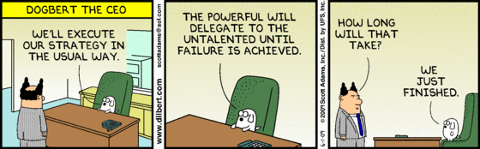
Impersonation Tokens
4 Impersonation Levels:
Anonymous - can impersonate the user as if they were an anonymous user
Identification - when a process can pull your token to validate credentials. Cant do anything with the token
Impersonation - Preform tasks as a different user on the local computer
Delegation - Highest level, the process can call resources and preform tasks on other computers.
Delegation is a feature provided by Kerberos

Slide 39
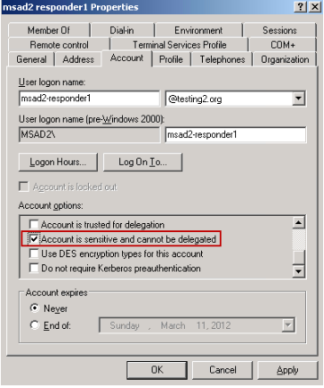
Impersonation Tokens
4 Impersonation Levels:
Anonymous - can impersonate the user as if they were an anonymous user
Identification - when a process can pull your token to validate credentials. Cant do anything with the token
Impersonation - Preform tasks as a different user on the local computer
Delegation - Highest level, the process can call resources and preform tasks on other computers.
Delegation is a feature provided by Kerberos

Slide 40
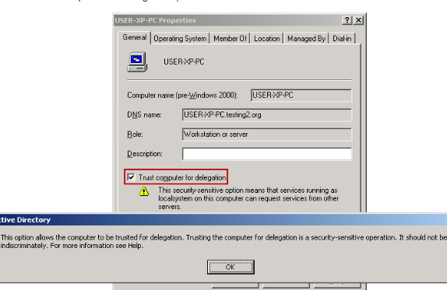
Impersonation Tokens
4 Impersonation Levels:
Anonymous - can impersonate the user as if they were an anonymous user
Identification - when a process can pull your token to validate credentials. Cant do anything with the token
Impersonation - Preform tasks as a different user on the local computer
Delegation - Highest level, the process can call resources and preform tasks on other computers.
Delegation is a feature provided by Kerberos

Slide 41
Logon vs. Authentication
Type | Description | Logon Right
2 | Interactive (logon at keyboard and screen of system) | Log on locally
3 | Network (i.e. connection to shared folder on this computer from elsewhere on network) | Access this computer from the network
4 | Batch (i.e. scheduled task) | Log on as a batch job
5 | Service (Service startup) | Log on as a service
7 | Unlock (i.e. unnattended workstation with password protected screen saver)
8 | NetworkCleartext (Logon with credentials sent in the clear text. Most often indicates a logon to IIS with "basic authentication")
9 | NewCredentials such as with RunAs or mapping a network drive with alternate credentials.MS says "A caller cloned its current token and specified new credentials for outbound connections. The new logon session has the same local identity, but uses different credentials for other network connections."
10 | RemoteInteractive (Terminal Services, Remote Desktop or Remote Assistance) | Log on through Terminal Services
11 | CachedInteractive (logon with cached domain credentials such as when logging on to a laptop when away from the network)
https://www.ultimatewindowssecurity.com/securitylog/encyclopedia/event.aspx?eventID=4624
Notes:
Logon occurs on the system to which a user is gaining access,
authentication is performed by the computer on which the user's account resides.

Slide 42
What token where? Why? Huh?
Impersonate-level tokens are present in remote network logons ~ SMB connections.
In the FTP server scenario, the ftp server is impersonating the privs of the remote user.
Delegate-Level tokens can be present in network logons as well.
This is needed in something like Sharepoint.
When you access the SP server, that server needs to be able to request resources on your behalf and thus requires a Delegation-level impersonation token.
FTP
Fred
FTP Server
Auth
Auth On behalf of Fred
Fred
Sharepoint
SQL Server

Slide 43
Authentication attacks
Attacking Kerberos authentication-service request
Attacker who can intercept the request can use the pre-auth as an oracle to crack the password.
Possible when using a weak password or downgraded encryption type.
Downgrade Attacks on Kerberos
Kerberos supports multiple encryption types.
During the AS-REQ, the client chooses the strongest encryption type available
MITM Attackers can modify the Server response and only present weak encryption types to use
Attacking NTLM
MITM the challenge response and pass-the-hash
NTLMv1 Can be cracked
NTLMv2 Can be downgraded in some cases
Both NTLMv1 and v2 can be used in Relay Attacks

Slide 44
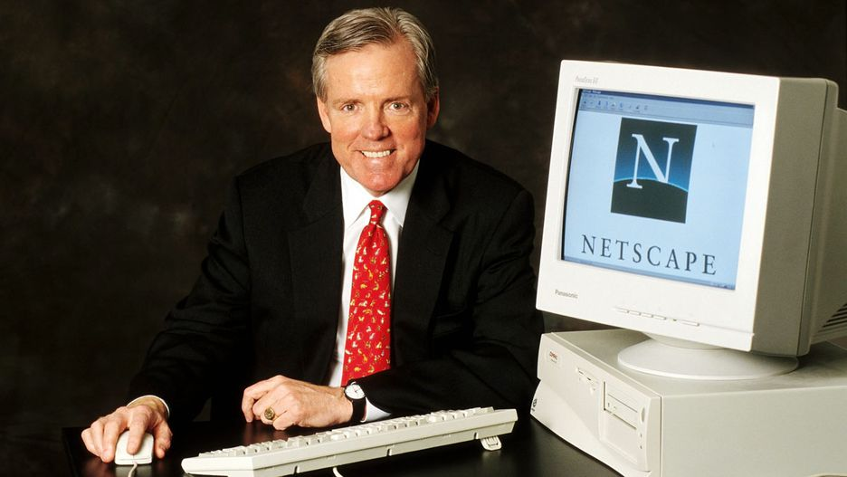
Pass the hash
Obtain a hashed credential
Without cracking it, re-use the hash to authenticate to some system.
Typically windows only, although affects authentication protocols in general dependent on the situation.
The attack exploits a weakness in the auth protocol
This isn’t a new attack
***not Paul Ashton
*First published by Paul Ashton in ’97** using a modified SambaSMB client that would accept hashes
**Year of the tamagotchi

Slide 45
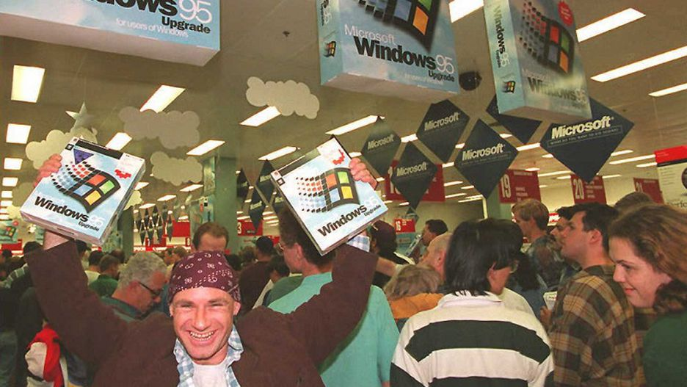
Pass the hash
Obtain a hashed credential
Without cracking it, re-use the hash to authenticate to some system.
Typically windows only, although affects authentication protocols in general dependent on the situation.
The attack exploits a weakness in the auth protocol
This isn’t a new attack
Found in Windows 95
*First published by Paul Ashton in ’97** using a modified SambaSMB client that would accept hashes
**Year of the tamagotchi

Slide 46
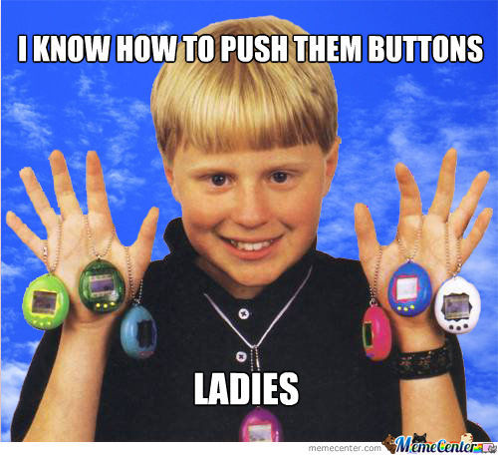
Pass the hash
Obtain a hashed credential
Without cracking it, re-use the hash to authenticate to some system.
Typically windows only, although affects authentication protocols in general dependent on the situation.
The attack exploits a weakness in the auth protocol
This isn’t a new attack
*First published by Paul Ashton in ’97** using a modified SambaSMB client that would accept hashes
**Year of the tamagotchi

Slide 47
NTLM Authentication
Computer makes an authentication request
2) DC answers with a challenge
3) Computer responds with challenge encrypted using password hash
4) DC checks if challenge response matches what it expects
https://www.ultimatewindowssecurity.com/securitylog/book/page.aspx?spid=chapter4
Notes:
Remember NTLM Auth?

Slide 48
NTLM Authentication
Computer makes an authentication request
2) DC answers with a challenge
3) Computer responds with challenge encrypted using password hash
4) DC checks if challenge response matches what it expects
Passing the hash becomes possible because of how this authentication works
The host uses a hash to encrypt the challenge, not a password.
https://www.ultimatewindowssecurity.com/securitylog/book/page.aspx?spid=chapter4
Notes:
WE CAN PASS HASHES BECAUSE OF HOW THAT WORKS

Slide 49
Pass the hash
You CAN perform Pass-The-Hash attacks with NTLM hashes.
You CANNOT perform Pass-The-Hash attacks with Net-NTLM hashes.
NetNTLMv1 v2 and NTLMv1 v2 are the same thing
BUT you can RELAY NTLMv1/v2 hashes!

Slide 50
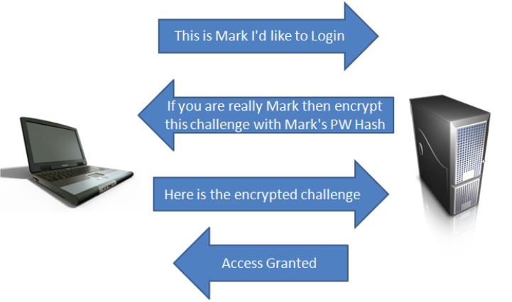
Relay Attacks
‘Normal’ Auth
https://pen-testing.sans.org/blog/2013/04/25/smb-relay-demystified-and-ntlmv2-pwnage-with-python

Slide 51
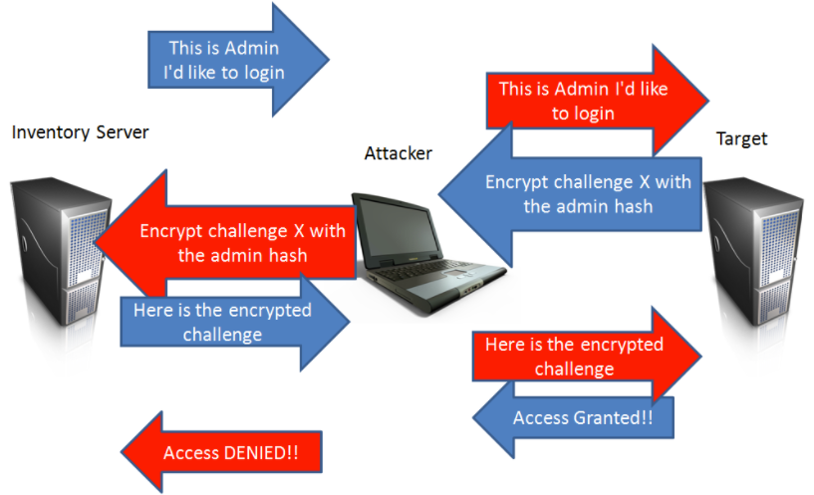
Relay Attacks
**requires that SMB signing is disabled
Responder | Inveigh with
Empire
Metasploit
CME
https://pen-testing.sans.org/blog/2013/04/25/smb-relay-demystified-and-ntlmv2-pwnage-with-python

Slide 52
Enter: Responder
“Responder is a LLMNR, NBT-NS and MDNS poisoner, with built-in HTTP/SMB/MSSQL/FTP/LDAP rogue authentication server supporting NTLMv1/NTLMv2/LMv2, Extended Security NTLMSSP and Basic HTTP authentication.”
https://github.com/lgandx/Responder
“Inveigh is a Windows PowerShell LLMNR/mDNS/NBNS spoofer/man-in-the-middle tool”
https://github.com/Kevin-Robertson/Inveigh

Slide 53
Multi-Relay == Responder++
Requires:
-SMB Signing set to not mandatory
-Victim credentials can authenticate to our target
Responder ‘responds’ to all NBT-NS and LLMNR lookups with our IP address
Multi-Relay will:
Capture the request
Modify the commands
Relay the payload to the target
If Successful in the relay, the payload is designed to start an interactive shell on the target machine

Slide 54
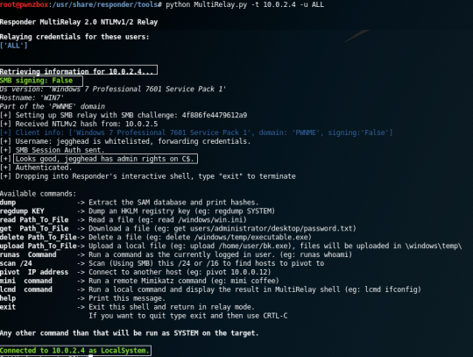
Multi-Relay == Responder++
Requires:
-SMB Signing not mandatory
-Victim credentials can authenticate to our target
Responder ‘responds’ to all NBT-NS and LLMNR lookups with our IP address
Multi-Relay will:
Capture the request
Modify the commands
Relay the payload to the target
If Successful in the relay, the payload is designed to start an interactive shell on the target machine

Slide 55

A Class(ic)ify Problem
If only we could get someone|something to authenticate to us…
Remember those ‘active’ classifiers
If it looks like a Windows box, talks like a Windows box, I better give it my overprivileged credentials!
Notes:
What the hell have I been talking about? Well, a simple attack.

Slide 56
The 60 Second pwn : Connect
Connects
Attacker

Slide 57
The 60 Second pwn : Setup Relay
Several ways to do this:
-Try everything on the /24 we land on
-Take IP - 1
-Quickly scan the /24 for hosts (script it up)
-Plug / Unplug to keep getting profiled
Connects
Attacker
Relay Target

Slide 58
The 60 Second pwn : Wait…
Attempts to identify host
Attacker
Relay Target

Slide 59
The 60 Second pwn : Wait…
Listening on 135,139,445
Looks at ports/services/domain/etc..
Attacker
Relay Target

Slide 60
The 60 Second pwn : Wait…
AUTHENTICATES TO HOST TO PULL PROCESS INFORMATION
Attacker
Relay Target

Slide 61
The 60 Second pwn : pWNED
Store received hash
Attempt to Pass-the-hash to target system
Get shell? Dump Creds? Take captured hash offline?
AUTHENTICATES TO HOST TO PULL PROCESS INFORMATION
Attacker
Relay Target

Slide 62
We didn’t even have to ask
That’s it!
From here we begin the lateral movement game to try and get cleartext creds.
Or change password, create a user
AUTHENTICATES TO HOST TO PULL PROCESS INFORMATION
Attacker
Relay Target

Slide 63

It’s a known problem
These devices are usually running with DA privs
Local Admin everywhere at least!
This isn’t new -
https://blog.rapid7.com/2014/10/14/palo-alto-networks-userid-credential-exposure/
HD Moore wrote ~
The issue applies to almost every systems management product and utility in the Windows Ecosystem
Hardening Whitepaper
https://hdm.io/writing/Mitigating%20Service%20Account%20Credential%20Theft%20on%20Windows.pdf
Notes:
We know these automated tools to maintain security could end up enabling an attack.

Slide 64
And that’s not all folks
Auditing tools/services
Authenticated Scanners
DevOps Host Management tools
Admin Scripts
How are you pushing out changes to endpoints?
I’m looking for test cases Hit me up!

Slide 65
Attacks on those service accounts
Relay Attacks
Cracking the password
Stealing the token and impersonating the user
Notes:
Depends on how it works.

Slide 66
Mitigation
Hardening Kerberos:
Disable weaker HMAC algorithms. Ideally only AES-256 should be enabled
Enable Kerberos Armoring - encrypts the AS-REQ’s with the computer key
Hardening NTLM:
Disable/Restrict NTLM auth inside the domain and only use Kerberos if possible - can do this in group policy
Disable NTLMv1 and force NTLMv2 ~ harder to crack.
Turn on SMB signing everywhere (its on by default ONLY on servers promoted to DC’s)
Disable SMBv1 - (unless you still have windows XP hosts)
Get rid of windows XP hosts!
Service Account Hardening:
Long Complex Passwords - Group Managed Service Accounts can handle auto-magic password changing
Prevent interactive logon types!
Deny access to external resources that support NTLM authentication
Check yo Privilege - least privileges needed.
Account Creation events from service accounts should be red flagged

Slide 67
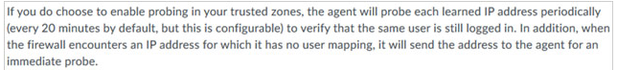
Mitigation
Palo’s can disable Client Probing
CA can do the same, and modify the type of authentication it would preform.
I would assume others have these types of settings as well?
I need test cases!

Slide 68
Detecting responder
https://github.com/Kevin-Robertson/Conveigh
Conveigh is a Windows PowerShell LLMNR/NBNS spoofer detection tool
Features:
Generates and sends IPv4 LLMNR/NBNS requests with random or set hostnames
Detects responses to sent IPv4 LLMNR/NBNS requests using a packet sniffer
Optionally displays all received IPv4 LLMNR/NBNS requests using a packet sniffer
File output
Run time control

Slide 69
General Defense
DAs- quit logging in! - don’t investigate with a DA account! You could get relayed/captured
Get rid of Local Admin Password Reuse! ~ use LAPS
Overprivileged Domain User accounts, Local Admin everywhere??!?
Trim Service accts from the DA group - backups, av
Change default creds on INTERNAL hosts - web servers, services
Prevent storing/caching credentials ~~ will prevent domain accounts from logging in if you cant reach a DC
Reduce PrivilegedGroup members
Stay up-to-date
MFA

Slide 70
RTFM
https://adsecurity.org/?page_id=1821
https://www.ultimatewindowssecurity.com/securitylog/encyclopedia/event.aspx?eventID=4624
https://www.ultimatewindowssecurity.com/securitylog/book/page.aspx?spid=chapter3
https://searchwindowsserver.techtarget.com/news/1214635/Tickets-tokens-and-the-Active-Directory-authentication-process
https://blog.cobaltstrike.com/2015/12/16/windows-access-tokens-and-alternate-credentials/
https://digital-forensics.sans.org/blog/2012/03/21/protecting-privileged-domain-accounts-access-tokens
https://docs.microsoft.com/en-us/windows/desktop/secauthz/access-tokens
https://en.wikipedia.org/wiki/Access_token
https://searchwindowsserver.techtarget.com/news/1217005/SID-filtering-usage-scenarios-and-configuration-for-Active-Directory
http://g-laurent.blogspot.com/2017/03/multirelay-20-runas-pivot-svc-and.html
https://hdm.io/writing/Mitigating%20Service%20Account%20Credential%20Theft%20on%20Windows.pdf
https://www.coalfire.com/The-Coalfire-Blog/August-2018/The-Dangers-Client-Probing-on-Palo-Alto-Firewalls
https://byt3bl33d3r.github.io/practical-guide-to-ntlm-relaying-in-2017-aka-getting-a-foothold-in-under-5-minutes.html

Slide 71
Ryan Preston ~ Depth Security Slides: https://github.com/AWSMHACKS
Twitter: @awsmhacks
Slack: awsm

